Slide 1
TypeWriter: Neural Type Prediction with Search-based Validation
Michael Pradel, Georgios Gousios, Jason Liu, Satish Chandra
Paper review by: Bishwajit Saha and Ankita Bhaumik

Slide 2
Static vs Dynamic typed languages
Static
The type of a variable is known at compile-time.
Data types are always consistent.
Strong IDE support.
Easy to handle APIs.
Extra compile time.
Ex. C, Java, Haskell
Dynamic
The type of a variable is checked during run-time.
Simple data compatibility errors
Poor IDE support.
APIs are hard to comprehend.
No added compile time.
Ex. Python, JavaScript

Slide 3
Strategies to add type annotations
Gradual types -> static type inference. – (Annotating types is painful)
Dynamic type inference at run time. – (Depends on inputs)
Probabilistic type prediction. – (Imprecision)

Slide 4
Probabilistic type prediction
Neural model
Identifiers
Comments
Token sequence
Type annotations

Slide 5
Limitations
Imprecision.
- No guarantee of correctness.
- Decision making is on the developers.
Combinatorial explosion
- Choosing from all combinations of the predicted types.
- Practically impossible.

Slide 6
Example
def find_match (color):
"""
Args:
color (str): color to match on and return
"""
candidates = get_colors()
for candidate in candidates:
if color == candidate:
return color
return None
def get_colors():
return ["red", "blue", "green"]
Predicted argument type:
bool
String
int
Predicted return type:
String
Optional [String]
None
Predicted return type:
List [String]
List [Any]
String

Slide 7
The TypeWriter approach
Program
Learning-based probabilistic type prediction
Feedback-directed search-based validation
Program with annotated types

Slide 8
Step 1: Static Extraction
1. Identifiers
Names of functions and arguments.
2. Token Sequences
Sequence of k tokens at every occurrence of the argument/return types.
3. Comments
Function level comments.
4. Available types
Extracts all locally defined or imported types.

Slide 9
Example
from x import Y
def find_match (color):
"""
Args:
color (str): color to match on and return
"""
candidates = get_colors()
for candidate in candidates:
if color == candidate:
return color
return None
def get_colors():
return ["red", "blue", "green"]
Available types from import
Identifiers – function names, argument names
Function level comments
Tokens around every occurrence of identifier
Notes:
abcd

Slide 10
Step 2: Neural Type Prediction Model
Neural model that predicts types from the statically extracted data.
Input -> identifiers, token sequences, comments and available types.
Output -> a probability distribution over a fixed set of types.
Method -> Recurrent neural network (RNN).

Slide 11
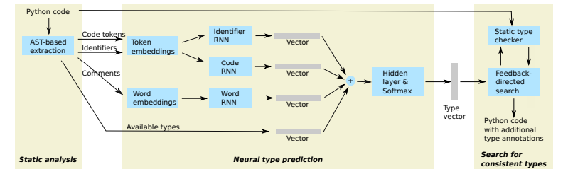
Architecture of TypeWriter

Slide 12
Step 3: Feedback-guided Search
Given -> type slots.
Output from previous step -> a list of probabilistic predictions for each slot (P).
Problem: How to assign the suggested types to the given slots?
Solution: Feedback score = v · number of missing types + w · number of type errors
Use gradual type checker that guides a search for consistent types
For example, pyre and mypy for Python, and flow for JavaScript

Slide 13
Search Space Exploration
Initial state
Next state 1
Next state 2
Next state 3
Using top most prediction from P
Modifying exactly one type slot
Calculate feedback score
Calculate feedback score
Calculate feedback score
Output state
State with minimum feedback score

Slide 14
Example
def find_match (color):
"""
Args:
color (str): color to match on and return
"""
candidates = get_colors()
for candidate in candidates:
if color == candidate:
return color
return None
def get_colors():
return ["red", "blue", "green"]
Predicted argument type:
bool
String
int
Predicted return type:
String
Optional [String]
None
Predicted return type:
List [String]
List [Any]
String

Slide 15
Example
def find_match (color):
"""
Args:
color (str): color to match on and return
"""
candidates = get_colors()
for candidate in candidates:
if color == candidate:
return color
return None
def get_colors():
return ["red", "blue", "green"]
Predicted argument type:
bool
String
int
Predicted return type:
String
Optional [String]
None
Predicted return type:
List [String]
List [Any]
String

Slide 16
Example
def find_match (color):
"""
Args:
color (str): color to match on and return
"""
candidates = get_colors()
for candidate in candidates:
if color == candidate:
return color
return None
def get_colors():
return ["red", "blue", "green"]
Predicted argument type:
bool
String
int
Predicted return type:
String
Optional [String]
None
No error!
Predicted return type:
List [String]
List [Any]
String

Slide 17
Variants of search technique
Greedy
NON GREEDY
Aggressively explores children of type assignment that decrease the feedback score
Prunes children of states that increase it.
Explores larger state space by backtracking to avoid local minima.
Performs no pruning.

Slide 18
Experimentation
Datasets used:
Multi-million line Python code from Facebook internal repository – Code corpora.
1,137 popular open source Python3 projects from GitHub.

Slide 19
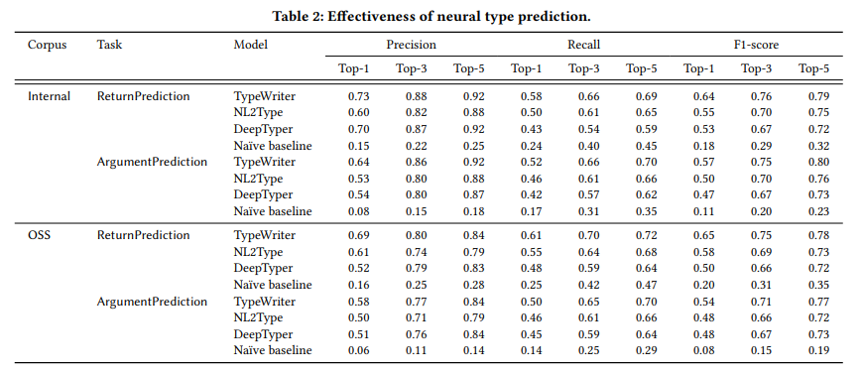
Results
Precision:
58-73% in Top-1 84-92% in Top-5
Recall:
50-58% in Top-1 69-72% in Top-5

Slide 20
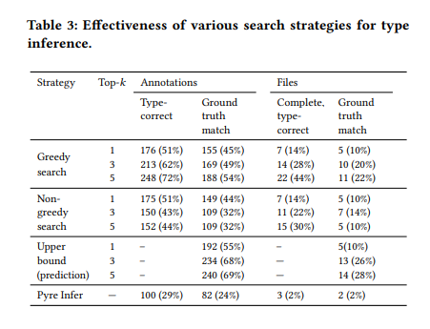
Results
Ground truth: 50 fully annotated files
346 Annotations

Slide 21
Future Work / Limitations
Aiming towards Type Soundness.
Limited type vocabulary - Fixed number of types available.
Faster search feedback – dependent on the performance of the gradual type checker.

Slide 22
Summary
First neural type prediction model for Python.
Learned model can readily predict correct type annotations for half of the type slots on first try.
The search component can then prevent annotating code with wrong types.
The greedy search approach discovers more type-correct annotations.
Currently used at Facebook that can annotate thousands of missing types.

Slide 23
Critique
What we liked?
The approach is very well explained with suitable examples.
Exact research questions have been addressed and supported with real time results.
Existing type predictors for JavaScript have been utilized with enhanced features.
What could be improved?
Details of RNN model not explained clearly.
Can reduce dependency on the gradual type checker.
Feedback score function is too rigid.
Bad commenting style may impact performance.

Slide 24
References
1. https://software-lab.org/publications/icse2019_NL2Type.pdf
2. https://discovery.ucl.ac.uk/id/eprint/10066386/1/Barr_fse2018-j2t.pdf

Slide 25
Thank you!
Questions?

